Slide 1
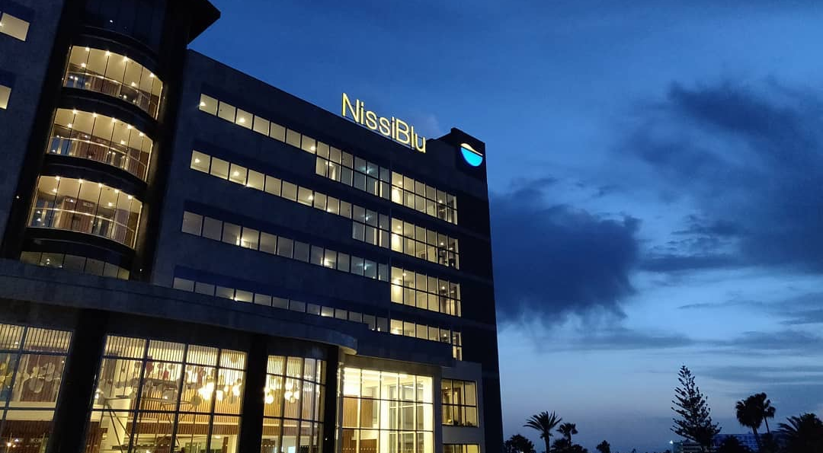

NISSIBLU BEACH RESORT

Slide 2
WELCOME
We are delighted to welcome you to NissiBlu Beach Resort!
At NissiBlu Beach Resort, we uphold the highest international hospitality standards, holding certifications in Quality Management (ISO 9001), Health and Safety (ISO 45001), and Food Safety (ISO 22000). In addition, we are honored to have received the Travelife Gold Award for our sustainability system.
For 2025, our goal is to certify the resort according to the Circular Economy standard. We are committed to operating in a way that conserves resources, reduces waste, and maximizes the reuse and recycling of materials, ensuring long-term value creation and minimal environmental impact.
We invite you to support our ongoing efforts by actively participating in our sustainability initiatives and following our guidelines during your stay or collaboration with us—whether you are an employee, supplier, or subcontractor. Your contribution is vital to achieving our environmental and social objectives.
We are proud to present our second sustainability report, which highlights the resort’s performance for the 2023–2024 period and outlines our goals for 2025. This report will be published annually to keep you informed about our progress.
If you have suggestions on how we can further improve our sustainability practices, please don’t hesitate to share them with us at quality@nissiblu.com.
Notes:
Βιωσιμότητα ή αειφορία είναι ένα πρότυπο παραγωγής το οποίο στοχεύει στο καλύτερο.

Slide 3
ABOUT US
Welcome to NissiBlu Beach Resort, a luxurious 5-star escape located in the heart of Ayia Napa, Cyprus, right by the iconic Nissi Beach. With its crystal-clear waters and golden sands just steps away, our resort offers the perfect setting for an unforgettable Mediterranean getaway.
At NissiBlu, we pride ourselves on providing guests with unparalleled comfort, elegant accommodations, and world-class amenities. Whether you're here for a romantic escape, a family vacation, or a relaxing solo retreat, you'll find everything you need for a memorable stay. Our rooms and suites are designed to blend modern sophistication with stunning sea views, offering a serene retreat after a day of sun and exploration.
Our resort features a variety of dining options, from Mediterranean delicacies at our gourmet restaurants to casual beachside bites. We also offer a fully-equipped fitness centre, a luxurious spa with a range of treatments, and both indoor and outdoor swimming pools. For those looking to explore, Ayia Napa's lively nightlife and cultural attractions are just a short distance away.
At NissiBlu Beach Resort, we are committed to sustainability and minimizing our environmental footprint, without compromising on the luxury experience. We aim to combine eco-friendly practices with exceptional hospitality, ensuring that your stay not only delights you but also contributes to preserving the beauty of our surroundings.
We look forward to welcoming you to our little piece of paradise!
Notes:
Βιωσιμότητα ή αειφορία είναι ένα πρότυπο παραγωγής το οποίο στοχεύει στο καλύτερο.

Slide 4
IMS POLICY
The management and staff of Nissiblu Beach Resort, consider quality and safety of our service, a top priority and an integral part of our corporate business principles. It is the commitment of the top management as well as staff to ensure the quality, safety & hygiene of our products, to meet the expectations of our customers, to manage our environmental aspects and contribute to the protection of the environment, prevention of pollution, while implementing Circular Economy Practises, as per corresponding appendix and ensuring preparedness and response during crisis.
Furthermore, we ensure the provision of a healthy & safe and secure environment free from occupational incidents, accidents and illnesses for our employees, our customers, our partners and anyone that may be affected by our processes, while we comply with all EU and national legislative requirements. At the same time, we act in full respect for human rights and treat all guests, visitors, suppliers, subcontractors, staff equally and with respect, without discriminating, regardless of age, sex, religion, nationality, political opinion, culture, sexual orientation, mobility or mental weaknesses and failures, economic or social status.
The success of our objectives requires the involvement of all of us and the perception of the limits of everyone's responsibility. In this context, Nissiblu Beach Resort is developing an Integrated Management System and has been certified with the sustainable award Travelife Gold and with the international standards of ISO 9001, ISO 45001 and ISO 22000. Through the implementation of the Integrated Management System (IMS), the hotel seeks to exceed the compliance with relevant legal requirements, to identify and meet the requirements of our customers, to act within both national and European legal frameworks and to continuously improve our products and services and the effectiveness of our processes, while at the same time we are committed to:
comply with existing legislation at both national and European level and in particular the laws, regulations and directives related with food safety and hygiene, environmental practises, occupational safety and health as well as security issues.
inform, educate and encourage all staff and partners for their active involvement in quality, food safety & hygiene issues, occupational health & safety and security issues, as well as in environmental protection and sustainability activities while we provide adequate and appropriate resources, infrastructure, equipment, science and human potential.
allocate duties for food safety & hygiene, environmental, health, safety and security issues through appointing competent persons with particular responsibilities and through associated manual documents and records.
introduce systematic identification, evaluation and control of all environmental aspects and impacts at the hotel as well as risks related to general activities that may affect among others the food safety & hygiene, the occupational safety and health as well as the security and safety of our staff, guests and any third person who may be affected by our activities.
act as such so as to minimize and safely dispose waste generated by the hotel, applying best available techniques, recovery techniques, reuse and recycle wherever possible
establish, document and review our measurable quality, food safety, environmental sustainability targets and programmes as well as the preventive occupational safety, health and security performance indicators & targets
inform guests, visitors, staff, suppliers and contractors working with the hotel for the Hotel’s IMS Policy (Quality, Environmental, Food Safety Policy, Occupational Safety and Health and Security Policy), the sustainability and community policy, the staff care policy and the child protection policy, while promoting and ensuring that they all comply with.
establish and maintain an open and creative relationship of trust with the local community and the general public
aim for continuous improvement of performance of the above through the Integrated Management System the effectiveness and appropriateness of which will be reviewed at least annually.
The Policy of the Integrated Management System of Nissiblu Beach Resort will be publicly available, implemented and maintained at all levels of the organization, whereas it will be reviewed and amended periodically by the management so as to ensure suitability of the organization’s role on the above sectors.
Notes:
Βιωσιμότητα ή αειφορία είναι ένα πρότυπο παραγωγής το οποίο στοχεύει στο καλύτερο.

Slide 5
COMMUNITY AND SUSTAINABILTY POLICY
We, Management and Staff alike of the Nissiblu Beach Resort, are committed to ensure that any of our actions have a positive impact on the local residential and business community, while at the same time through our actions we aim to protect our local traditions. In this respect we are working to ensure positive social and economic impact and where this is not possible, to minimize them to acceptable levels. Our main objectives relating to society and our responsibility towards it, are directly connected with the following:
1. Certifications
Travelife Award: In our efforts for the satisfaction of wider sustainability criteria, including socio-economic impacts and staff welfare, we have implemented Travelife’s requirements and obtain the Gold award.
ISO 22000: Food Safety and Hygiene being one of our top priorities, we fully comply with the national and EU regulations thus have assessed the potential risks related to the food handling chain in our hotel, have identified the Critical Control Points and have created a monitoring and control plan to ensure that they do not exceed critical limits. At the same time, we ensure that all food handlers conform with the applicable rules and policies in terms of safety and hygiene of food and personal hygiene. To this end our hotel has been certified with the international food safety and hygiene standard ISO 22000.
ISO 9001: Alongside with the above management systems we have fully incorporated quality management procedures in accordance with the requirements of the international standard ISO 9001, through which we aim to identify and satisfy our customers' requirements, while we will be acting within the national legal framework and we will continuously be improving our products and services, and the effectiveness of our processes. To this end we have certified our quality management system according to ISO 9001 requirements.
ISO 45001: Occupational Safety & Health, being an integral part of our legislative obligations, is also applied while we aim to supersede the compliance with the relevant OH&S legislation thus, we have included security issues that may affect our staff, guests and any third party affected by our activities. Considering that the primary goal of our company is to maintain a secure, safe, and healthy workplace free from accidents or occupational diseases both for our guests in and partners, our employees and those who may be affected by our operations, we have integrated the requirements of the international standard ISO 45001 and the hotel has been certified with ISO 45001.
Circular Economy Initiatives: As part of our commitment to adopting circular economy practices, the hotel actively participates in a sponsorship program designed to promote sustainable operations within hospitality facilities. Recognized for its dedication, the hotel has achieved selection for the prestigious Gold Round of the program and is on track to receive certification by the end of 2026.
Greenhouse Gas Emissions Reduction: The hotel is also engaged in a comprehensive initiative to reduce greenhouse gas emissions across business operations. By aligning with the requirements of this program, the hotel aims to achieve full certification by the close of 2025, reinforcing its dedication to environmental sustainability.
2. Promotion of responsible tourism in the area
The hotel's management fully supports responsible tourism in the area of Ayia Napa thus is in continuous communication with local authorities and the Cyprus Hotel Association and is kept informed at all times on issues relating to the improvement of the residential and business community both financially and socially. In addition, it actively participates and promotes any organized events related with Cyprus’s Local Traditions.
Notes:
Βιωσιμότητα ή αειφορία είναι ένα πρότυπο παραγωγής το οποίο στοχεύει στο καλύτερο.

Slide 6
COMMUNITY AND SUSTAINABILTY POLICY
3. Purchases
Our policy is to give priority to:
Products from the local community, ensuring the quality and safety of our products, avoiding transport, and helping to reduce CO2 emissions.
Small business suppliers to enhance the local community and economy, who operate environmental standards in regard to production and packaging and who help and are present in the local community, and act to help maintain jobs and local traditions and customs
Products that are made from recycled products, are sustainably produced, energy efficient and water saving, delivered in less packaging and bear a Fair Trade/Organic/FSC/MSC label.
4. Employment
Recognizing the importance of long-term support of the local community, our company’s policy regarding employment is prioritizing the employment of local population. In this respect the majority of wages will be spent locally and the chain of other businesses in the community will be helped, therefore the viability of our community will be supported and enforced, which is part of our unique newly developed hospitality product.
Recognizing the responsibilities and our obligations regarding the employment of young people (children and adolescents) we fully comply with our obligations under the UN Convention on the Rights of the Child (ILO C182 & ILO C138) and the national legislative requirements.
Recognizing the right of association, we provide our employees with the right to be members of Unions as well as meet during their work to discuss issues that concern them without the involvement of the management of our hotel while we ensure excellent working conditions and protection of human rights.
Commitment to equal opportunities and will not excluded or show favour to specific groups of people during our recruitment processes. This includes, but not limited to, excluding or showing favour to people based on their race, nationality, religion, gender, sexuality or disabilities.
Decisions regarding employees’ pay, benefits, development and employment terms are based solely on experience and skills.
5.Donations and Charity Actions
It is the policy of our hotel to organize events and actively contribute and support charitable actions, associations, foundations and any social events through donations or active participation. Our first sustainability and community report will be issued at the end of 2024.
6. Community Integration
Fair play, ethical values ​​and virtues being our aim, we believe that all the employees regardless of color, nationality, sex, religion, political, economic, physical or mental status have the same rights and should be treated in the same way as all are part of our team and our vision. Further everyone, top management, management and employees respect human rights and are committed as to ensure respect and protection of minorities and vulnerable groups such as children, teenagers and women, from all forms of discrimination, abuse, exploitation and violence, including sexual exploitation. There is a procedure in place as per which we are able to identify and handle any incidents while following reporting them direct to the management of the hotel so as to proceed with the necessary discreet investigation and actions with the local authorities if required. In this respect any of our employees, esteemed guests or other stakeholder may contact us at 23 200500 and may ask for the hotel manager who would undertake any cases as such or report it directly to the Social Services/ Police at 00357 23803030.
Notes:
Βιωσιμότητα ή αειφορία είναι ένα πρότυπο παραγωγής το οποίο στοχεύει στο καλύτερο.

Slide 7
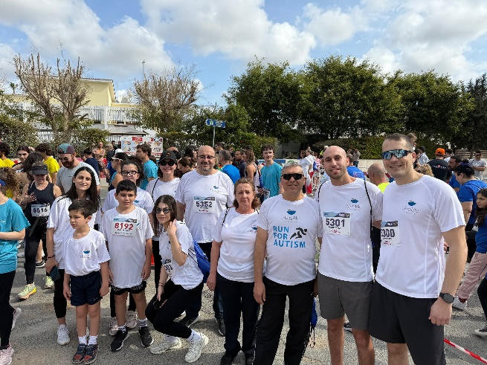
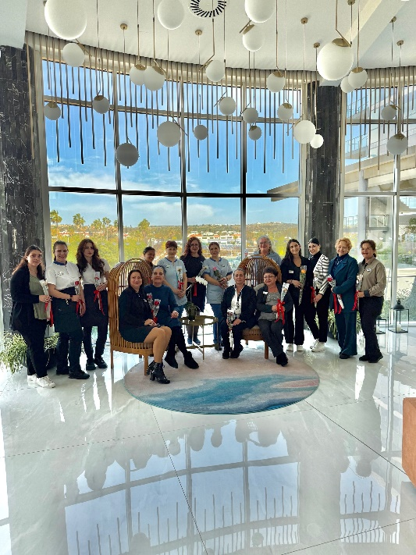
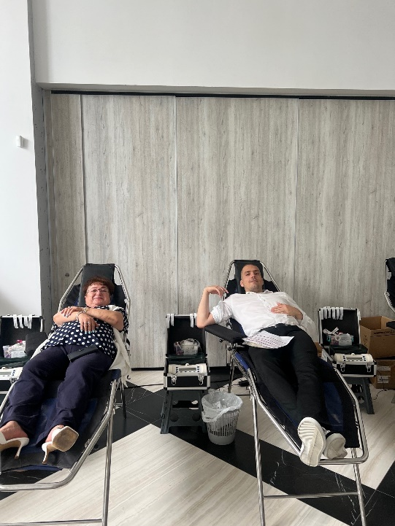
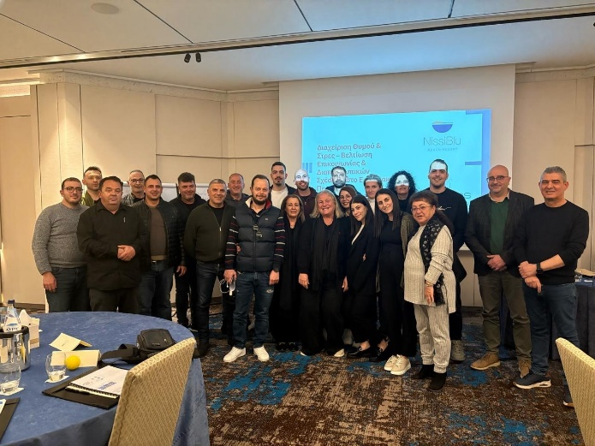
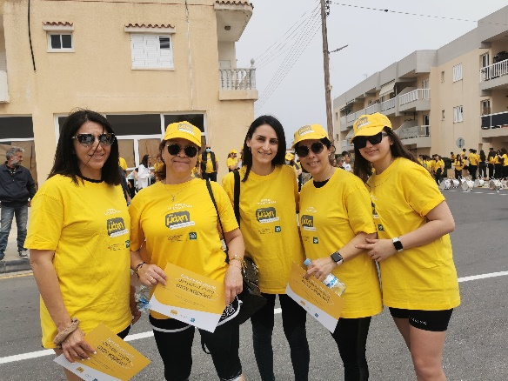
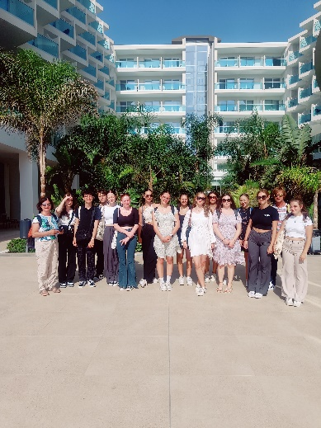
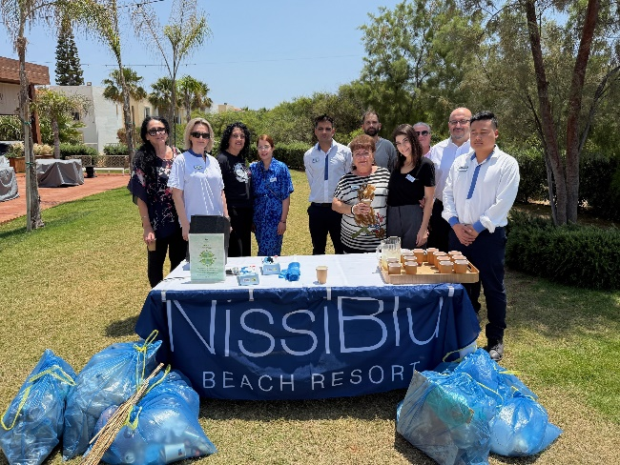
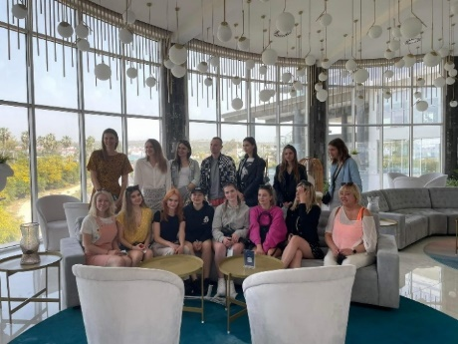
COMMUNITY AND SUSTAINABILITY EVENTS
Notes:
Βιωσιμότητα ή αειφορία είναι ένα πρότυπο παραγωγής το οποίο στοχεύει στο καλύτερο.

Slide 8
STAFF CARE POLICY
The management of our hotel, recognizing that the staff is the foundation stone and the driving force for achieving our goals and the satisfaction of our customers, has set as its priority the prosperity of our staff while also committing itself to:
Treating all employees equally and respectfully, without discriminations and by giving equal and same employment opportunities as well as rights and to all employees regardless of age, sex, religion, nationality, political opinion, culture, sexual orientation, reduced mobility or mental health and dysfunctions, economic or social status.
Setting as one of our priorities the development of staff skills and training as the main concern as of employees’ recruitment and throughout the course of employment, through a relevant training protocol.
Taking into account any special requirements and provide facilities to staff while at the same time takes into consideration any suggestions staff makes on any issues, while allowing staff to meet and discuss matters of their concern during working hours and at the same time setting goals regarding staff’s welfare and employment conditions.
Complying with all legal requirements pertaining to labor issues.
Being on process of adopting staff reward systems as a thanking gesture for the staff’s contribution in achieving the company’s goals through staff’s hard working.
Conducts monthly staff meetings with all staff so as to discuss amongst other issues of concern.
Offer a safe and secure working environment to all staff
This policy will review and update annually to reflect changes in legislation and company practices.
Notes:
Βιωσιμότητα ή αειφορία είναι ένα πρότυπο παραγωγής το οποίο στοχεύει στο καλύτερο.

Slide 9

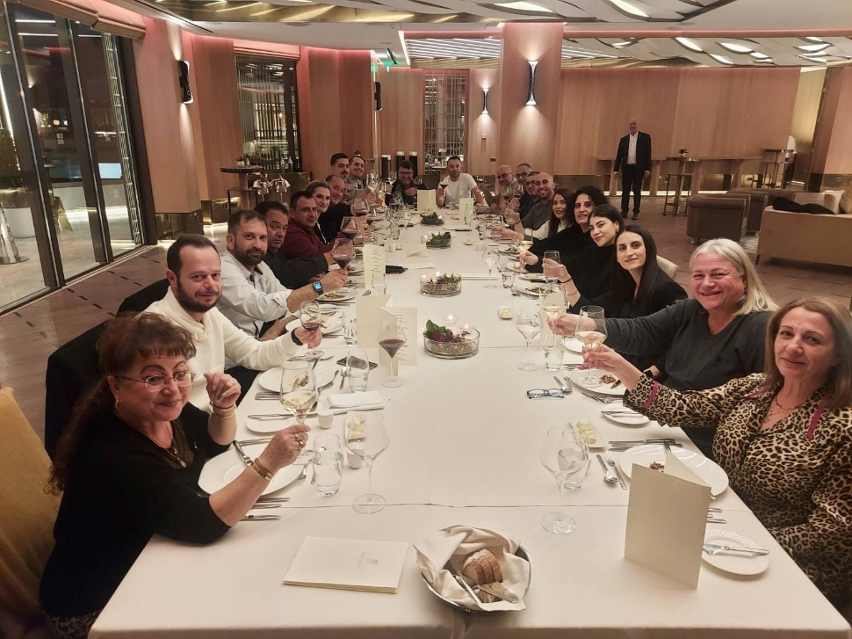
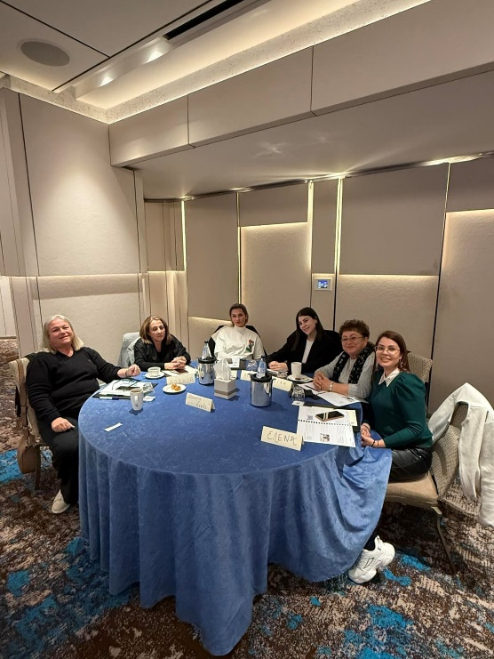
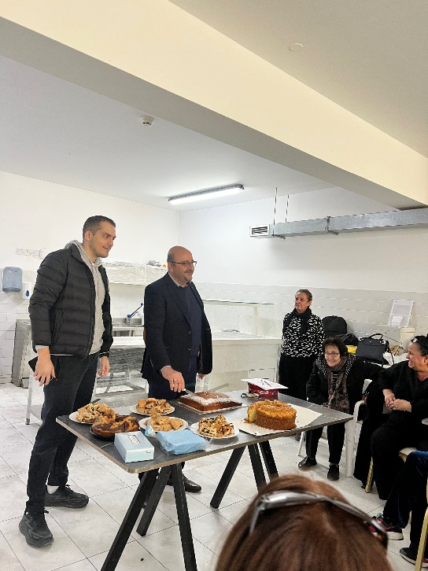
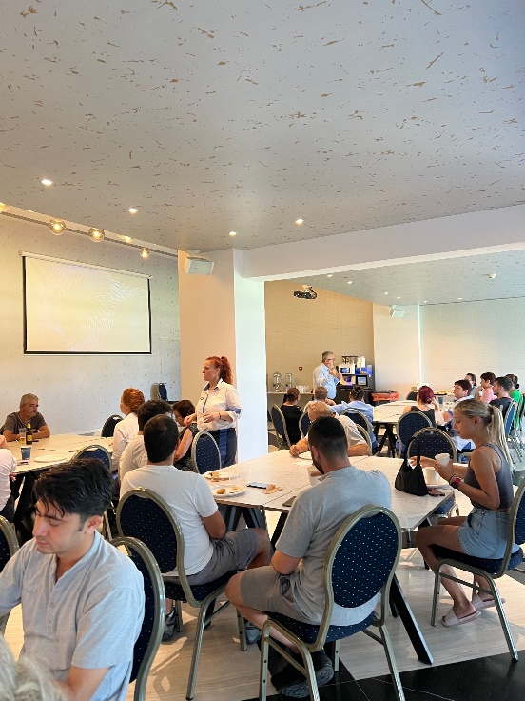
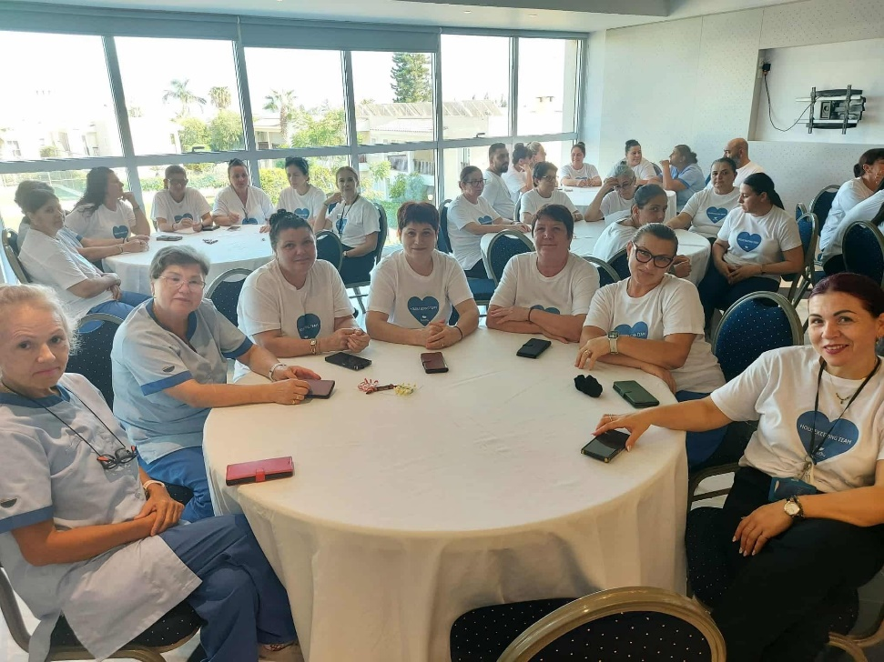
STAFF CARE POLICY
International Women's Day
Get together Staff Dinner
Seminar Day
Beginning of New Season 2025
Get together coffee&cookies
Housekeeping week
Notes:
Βιωσιμότητα ή αειφορία είναι ένα πρότυπο παραγωγής το οποίο στοχεύει στο καλύτερο.

Slide 10
CHILDREN PROTECTION POLICY
Nissiblu Beach Resort inevitably supports that no child, nor any young person should experience any kind of abuse either physical or emotional or sexual, neglect or exploitation. Thus fully acknowledges and conforms with the UN Convention on the Rights of Children and is thus committed in respecting and safeguarding all children and young people under the age of 18, either who stay in our hotel or those who work or live in our community, ensuring that they are protected from all forms of abuse, exploitation or neglect.
We support the vital welfare of children and young persons, the right of all children or young people under the age of 18 to equal protection from abuse, neglect or exploitation, irrespective of their age, disability, gender, race, religious belief, sexual orientation or sexuality. We are in continuous contact with local children organizations such as Apostolos Varnavas School, and we are welcoming charities while we ensure that all our actions are robust and effective through law enforcement when and if needed.
The hotel will not offer, promote or otherwise commercially benefit from any activities, attractions or events involving people under the age of 18 when the operator cannot verify to us that they comply with all relevant laws including the UN Convention on the Rights of the Child and ILO Conventions 138/182.
Last but not least we commit ourselves to concentrate our efforts on listening to respecting children and youngsters, training our staff on this present policy, which is to be promoted to all associates, so that they are sensitive to the signs of child abuse, neglect or exploitation and are aware of the actions they need to take to safeguard a child that they suspect may be at risk in or around our property.
In case anyone suspects abuse, neglect or exploitation of a child, please inform reception immediately at 23 200500 or the police station at 00357 23803030.
This policy will review and update annually to reflect changes in legislation, technology, and company practices
Notes:
Βιωσιμότητα ή αειφορία είναι ένα πρότυπο παραγωγής το οποίο στοχεύει στο καλύτερο.

Slide 11
ENVIRONMENTAL POLICY
The management and staff of Nissiblu Beach Resort, recognises environmental sustainability as a top priority and integral part of our corporate business principles, therefore Nissiblu Beach Resort commits to conduct the hotels operation in a manner that secures environmental sustainability and minimizes the negative impact on the planet. It is the dedication of the top management as well as staff to ensure that our guests’ expectations are attained while managing our environmental aspects and contribute to the protection of the environment.
This policy applies to all staff, contractors, and stakeholders involved in the operations of Nissiblu Beach Resort and is committed to upholding this environmental policy and encourages all employees, contractors and stakeholders to contribute to achieving our environmental goals. This policy will be communicated to all staff and stakeholders and will be available to the public through our website and other communication channels.
Nissiblu Beach Resort is committed to protecting and supporting the environment, including biodevirsity, through continual improvement in environmental performance and helping to limit the climate change by implementing actions to reduce our greenhouse gas emissions. We aim to reduce our ecological footprint and contribute to a sustainable future by adhering to the following actions:
Sustainability: We prioritize sustainability in all business activities and decisions promoting practises that support long-term ecological balance
Compliance: we comply with all applicable environmental laws and regulations
Prevention: we seek to prevent pollution and reduce hotels’ waste
Efficiency: We strive to use resources efficiently, minimizing energy and water consumption
Continuous improvement: we are committed to the ongoing enhancement of our environmental practises
Circular Economy: By implementing Circular Economy Practises as per corresponding appendix
Employee engagement: Educate and engage staff in environmental best practices and initiatives
Green suppliers: Favour suppliers that adhere to environmental standards and practices.
Supporting biodiversity: Each year the hotel organises a cleaning event to reduce the plastic pollution in the oceans which threatens marine animals and human health
Nissiblu Beach Resort will regularly monitor environmental performance through audits and meetings. This policy will review and update annually to reflect changes in legislation, technology, and company practices.
Notes:
Βιωσιμότητα ή αειφορία είναι ένα πρότυπο παραγωγής το οποίο στοχεύει στο καλύτερο.

Slide 12
CIRCULAR ECONOMY
The management and staff of Nissiblu Beach Resort recognise the circular economy as a core principle of sustainable development and an integral part of our corporate responsibility. We are committed to operating our hotel in a way that conserves resources, reduces waste, and maximises the reuse and recycling of materials, ensuring long-term value creation and minimal environmental impact.
It is the dedication of both top management and staff to meet and exceed our guests’ expectations while embedding circular economy practices into our daily operations. This policy applies to all employees, contractors, and stakeholders, and we encourage their active participation in achieving our circular economy goals. The policy will be shared with all relevant parties and made publicly available through our website and communication channels.
Nissiblu Beach Resort is committed to advancing a circular economy by continually improving our operational performance, supporting resource efficiency, and minimising greenhouse gas emissions. By embracing circular principles, we aim to reduce our ecological footprint, extend the lifecycle of products and materials, and contribute to a sustainable future. To achieve this, we will:
Circular design and procurement: Prioritise products, materials, and services designed for durability, repairability, and recyclability.
Waste reduction: Implement systems to prevent waste generation and ensure materials are reused, repaired, or recycled wherever possible.
Resource efficiency: Optimise energy, water, and raw material use to reduce consumption and environmental impact.
Supplier collaboration: Partner with suppliers who embrace circular economy practices and support closed-loop supply chains.
Innovation and continuous improvement: Regularly review operations to identify opportunities for circular solutions and improve our practices.
Employee engagement: Educate and empower staff to adopt circular practices, fostering a culture of responsibility and innovation.
Guest participation: Encourage our guests to engage in recycling, reuse initiatives, and responsible consumption during their stay.
Monitoring and transparency: Track progress through audits and reviews, reporting achievements and areas for improvement.
This policy will be reviewed and updated annually to reflect advancements in circular economy strategies, evolving legislation, and technological developments. By adopting these principles, Nissiblu Beach Resort is dedicated to transforming its operations toward a regenerative and resource-responsible future.
Notes:
Βιωσιμότητα ή αειφορία είναι ένα πρότυπο παραγωγής το οποίο στοχεύει στο καλύτερο.

Slide 13
ANIMAL WELFARE POLICY
Animal welfare
When we procure animal products that have been harvested or hunted from the wild, we will make every effort to ensure that sustainable and humane practices are used.
We will not offer, promote, sell or otherwise commercially benefit from any animal activities that involve the following practices:
Animal breeding or commercial trade in sanctuaries and orphanages.
Any tourist holding of, or photo opportunity with, wild animals where the animal does not have the choice of terminating the interaction or moving away.
Performances or tourist interactions involving animals where training involves punishment or food deprivation, causes the animal fear, injury or distress, or the tasks are not based on normal behaviour.
Tourist contact or feeding elephants without a barrier.
Elephant shows or performances for tourists.
Tourist contact, feeding of and ‘walking with’ wild cats.
Tourist contact or feeding of crocodiles, alligators, great apes (chimpanzees, orangutans, gorillas, bonobos), bears or sloths.
Tourist contact or feeding of orca and unsupervised tourist feeding of cetaceans.
Feeding any animals with live vertebrate prey.
Canned hunting.
Ostrich riding (observing or participating).
Unlicensed zoos.
Euthanasia, unless carried out by a trained professional because welfare needs cannot be met, or because the animal cannot be released into the wild.
Acquisition of any CITES Appendix I, II or III listed species except for demonstrable conservation or rescue/rehabilitation purposes.
Bear pits.
Bear-bile farms.
Tiger farms.
Notes:
Βιωσιμότητα ή αειφορία είναι ένα πρότυπο παραγωγής το οποίο στοχεύει στο καλύτερο.

Slide 14
RESPONSIBLE GUEST GUIDE
Aiming towards achieving our Travelife Sustainability Certification and within the frames of our sustainability policy, below are some simple actions you can take to support the people and places you visit.
We all travel for different reasons and many of us would agree that one of the best things about travel is having new and unique experiences. Because people, culture, history, wildlife and scenery play such important roles in our travel experiences, protecting and supporting these things should be at the heart of every tourism and travel organisation, and every traveller.
Travelife certification helps accommodation providers put sustainability at the heart of their business. Travelife Certified properties must achieve 100% compliance with one of the toughest accommodation sustainability standards in the world, something which is verified by conducting a full site audit of each property every 2 years. Travelife has conducted thousands of these audits all over the world and has found that the greatest impact comes when many individuals take simple actions, and that no matter how hard an accommodation provider works to improve, they are only successful if their guests are also willing to take some simple actions too. In this respect we invite you to keep reading to find out how you can help to improve the impact of your travel.
Notes:
Βιωσιμότητα ή αειφορία είναι ένα πρότυπο παραγωγής το οποίο στοχεύει στο καλύτερο.

Slide 15
RESPONSIBLE GUEST GUIDE
Researching your trip
Booking travel: If you have a choice, always opt for the company that is taking action to improve their environmental and social impacts. The best ones will publish annual sustainability reports and be independently certified by a reputable sustainability label like Travelife.
Culture: Travel is more enjoyable when you have some knowledge of how to respect local customs and culture. Even simple things like how to tip, dress or say thank you are useful to know before you arrive.
Ground transport: You can help ease congestion, pollution and emissions by opting for taxi and transfer companies with low-emission fleets, using public transport and exploring the destination on foot or by bike when it is safe and practical to do so.
Caring for others: Spend some time learning how to identify the signs that someone is being trafficked, abused or exploited, then find out how to report it if you ever see it. You should be able to find reputable information and training resources online, often provided by the police or an NGO, otherwise ask for advice from a relevant local charity or check with your travel agent as well as our Hotel. Please reach out to our reception and our colleagues will correspondingly guide you.
Notes:
Βιωσιμότητα ή αειφορία είναι ένα πρότυπο παραγωγής το οποίο στοχεύει στο καλύτερο.

Slide 16
RESPONSIBLE GUEST GUIDE
Packing
Pack light: Whether you are travelling by plane, train, ship or car, a lighter load means that less fuel is required to complete the journey, leading to lower emissions.
Pack to bring it back: Unwanted items you leave behind add to pollution in destinations that lack good waste and recycling solutions, and in all destinations they add stress to local waste management systems.
Personal care products: Washing or swimming when using shampoos, lotions and gels that contain ‘microbeads’ can cause serious long-term harm to biodiversity. Many countries have already banned them so please do not travel with these items.
Sunscreens: Certain ingredients found in some sun protection products are very damaging to marine life and reefs, even in tiny amounts and even from showering them off in your hotel room. Look for a marine-safe alternative if a sunscreen contains any of these ingredients: Oxybenzone, Benzophenone-1, Benzophenone-8, OD-PABA, 4-Methylbenzylidene Camphor, 3-Benzylidene Camphor, nano-Titanium Dioxide, nano-Zinc Oxide, Octinoxate, Octocrylene.
Single-use plastics: If you bring them with you then they will have to be disposed of and many destinations lack the facilities to do this safely. See if you can travel with reusable alternatives or ones made from recycled paper products instead of plastic.
Notes:
Βιωσιμότητα ή αειφορία είναι ένα πρότυπο παραγωγής το οποίο στοχεύει στο καλύτερο.

Slide 17
RESPONSIBLE GUEST GUIDE
At your accommodation
Temperature: Keeping your room at a comfortable temperature is important yet this is one of the biggest contributors to greenhouse gas emissions in accommodation. You can help by not adjusting the thermostat more than necessary and by ensuring that heating/cooling units are turned off whenever doors or windows are open.
Water: There are always greenhouse gas emissions created from sourcing and disposing of water, and in some destinations water is an extremely precious resource. You can help by taking shorter showers, turning off the tap whilst brushing your teeth and making use of any low-flush option on toilets.
Eating & drinking: Around a third of all food produced is never eaten, yet food production accounts for a third of all greenhouse gas emissions. You can help by only ordering what you will eat, choosing local items over imported ones and opting for more meat-free meals during your stay.
Find out about recycling: Every location has different recycling rules that can be confusing when you travel, so ask hotel staff about what you can recycle and how.
Notes:
Βιωσιμότητα ή αειφορία είναι ένα πρότυπο παραγωγής το οποίο στοχεύει στο καλύτερο.

Slide 18
RESPONSIBLE GUEST GUIDE
At your accommodation
Temperature: Keeping your room at a comfortable temperature is important yet this is one of the biggest contributors to greenhouse gas emissions in accommodation. You can help by not adjusting the thermostat more than necessary and by ensuring that heating/cooling units are turned off whenever doors or windows are open.
Water: There are always greenhouse gas emissions created from sourcing and disposing of water, and in some destinations water is an extremely precious resource. You can help by taking shorter showers, turning off the tap whilst brushing your teeth and making use of any low-flush option on toilets.
Eating & drinking: Around a third of all food produced is never eaten, yet food production accounts for a third of all greenhouse gas emissions. You can help by only ordering what you will eat, choosing local items over imported ones and opting for more meat-free meals during your stay.
Find out about recycling: Every location has different recycling rules that can be confusing when you travel, so ask hotel staff about what you can recycle and how.
Notes:
Βιωσιμότητα ή αειφορία είναι ένα πρότυπο παραγωγής το οποίο στοχεύει στο καλύτερο.

Slide 19
RESPONSIBLE GUEST GUIDE
Supporting the local community
Support local businesses: Try to dine and shop at locally owned and operated businesses in the area. If you are buying gifts or mementos, see if you can find something that is handcrafted by a local artist or produced by a small business.
Explore the culture and area: Even if you are on a lazy beach holiday or a short business trip, you are likely to get more out of your visit if you find time to take in some of the local sites, culture and activities.
Respecting people: Make sure you know about, and observe, any local laws, customs or traditions. Do not take photos or videos of people without their permission, especially if you intend to post these online. Remember that only parents or legal guardians can give permission for children.
Safeguard children: Avoid activities that could harm children such as orphanage and school visits that can disrupt education or lead to exploitation. The best way to support children is to donate to a reputable charity. If you suspect that any child is being exploited or abused, immediately report the issue to law enforcement. You can speak with accommodation staff or your travel agent if you are not sure how do that safely.
Protect biodiversity: Be sure to properly dispose of your waste and follow any guidance about how to protect sensitive areas such as sand dunes, reefs or forests. Do not take anything away from these areas such as shells or stones and likewise, do not leave anything behind.
Support local improvement initiatives: If you have had a great time at your destination and would like to give something back to the people who live there, then we suggest looking for a local improvement initiative or charity to support. You could ask staff at your accommodation for ideas as they may already have something in place. For example, raising funds to build a new medical centre, to improve a local park or to protect an important natural area.
Notes:
Βιωσιμότητα ή αειφορία είναι ένα πρότυπο παραγωγής το οποίο στοχεύει στο καλύτερο.

Slide 20
RESPONSIBLE GUEST GUIDE
Safeguarding animals
Stray or abused animals: If you are concerned about stray or abused animals, ask staff at your accommodation about the best course of action. They may already be working with a local animal welfare organisation or have some advice for you. If not, you can ask your travel agent. International organisations like World Animal Protection and Born Free often have online advice about what to do if you see abuse or neglect of captive wild animals (e.g. snakes, tigers, bears, elephants).
Animal activities & attractions: We suggest that you avoid any activities that could possibly be harmful to the mental or physical wellbeing of animals. This could include activities involving feeding or touching wild animals and any attractions where animals are forced to behave in a way that would not be normal for them in the wild.
Notes:
Βιωσιμότητα ή αειφορία είναι ένα πρότυπο παραγωγής το οποίο στοχεύει στο καλύτερο.

Slide 21
RESPONSIBLE HOSPITALITY GUIDE
Responsible Hospitality Guide
Simple actions hospitality staff can take to support people and the environment.
Dear colleagues , our Hotel aims to renew its Travelife certificate by the end of 2024. We should all be proud that we work for an organisation that must achieve 100% compliance with one of the toughest accommodation sustainability standards in the world.
Our compliance will be verified through a full site audit this coming October and then every 2 years. Travelife has advised that organizations that have the most success with sustainability are the ones that have the full support of their staff and guests, all of whom are willing to make small changes and take simple actions that collectively result in meaningful impacts on the local area and the people who live there.
In this guide Travelife has suggested some of those small changes and simple actions that we can take. If you have any more ideas about how our workplace can be more sustainable, then be sure to provide that feedback to us.
Notes:
Βιωσιμότητα ή αειφορία είναι ένα πρότυπο παραγωγής το οποίο στοχεύει στο καλύτερο.

Slide 22
RESPONSIBLE HOSPITALITY GUIDE
Supporting our community
Respecting people: It is important that people in our community feel the benefits of tourism, and that they are important to our organisation. You can help by treating local people with the same level of respect and courtesy that you give to guests. Please do not take any photos or videos of people without their permission, especially if you intend to post these online. Remember that parents or legal guardians must give permission for children.
Protecting important cultural or historical sites: These sites could be buildings or locations involving history, culture, religion or science. They could also be areas considered sacred by indigenous peoples. It is important that you are aware of these sites in your community, and how to protect and respect them when you visit. Not only are they important to people in your area, but they could also be part of the reason why tourists visit in the first place.
Protecting the local way of life: Tourism can provide important economic and social benefits to people, but only if does not negatively affect their safety, customs, traditions or way of life. You can help by following any guidelines given to you about how to keep people in your community safe, especially the most vulnerable. Also, if you are not already familiar with all of the customs and traditions in the area, then we encourage you to spend time learning about them so that you know how to respect them.
Protecting vulnerable people: Travelife Certified properties and our property consequently, must provide staff with regular training about how to identify and report signs of child exploitation or abuse. You are encouraged to follow any guidelines you are given about how to identify and report the signs that adults are being trafficked, abused or exploited and report this to your head of dept or the Hotel Management.
Notes:
Βιωσιμότητα ή αειφορία είναι ένα πρότυπο παραγωγής το οποίο στοχεύει στο καλύτερο.

Slide 23
RESPONSIBLE HOSPITALITY GUIDE
Protecting & supporting the environment
Waste: There is a lot of waste generated in the hospitality sector and you may not realise that in addition to harming biodiversity, waste is a major contributor to greenhouse gas emissions. You can help to reduce these by following the guidelines given to you about how to properly handle waste at work, particularly when it comes to recycling.
Food: Around 30% of all food produced globally is never eaten yet food production produces 30% of all of the world’s greenhouse gas emissions. You can help by following any guidelines you are given about how to prevent food waste. When composting will be made available in our area, then be sure to use it properly as this can reduce the greenhouse emissions from food waste by over 90%.
Heating & cooling: Whenever we open a door to a space where the temperature is regulated, such as a heated office, air-conditioned guest room, fridge or oven, air from the inside escapes and air from the outside comes inside. This means that equipment like fridges, freezers, ovens and air-conditioners have to work hard to regulate the temperature again and the longer a door or window is left open, the more energy is used to regulate the temperature. You can make a big difference by taking a moment to close doors to any of these spaces.
Monitoring room temperatures: You can help to reduce emissions from heating and cooling systems by not adjusting thermostats more than is necessary, turning off fans when they are not needed and remembering to turn the air-conditioning off whenever you have doors or windows open (unless this happens automatically).
Using equipment efficiently: An important part of reducing emissions and pollution is being sure that appliances and other equipment are operated correctly and are switched off when not in use unless there is a health and safety reason why they need to be kept running.
Conserving water: This is a precious resource and there are always greenhouse gas emissions created from the sourcing and disposal of water. You can help by remembering to never leave water running when it is not immediately being used and by making use of any low-flush options on toilets.
Commuting: If you drive yourself to work, you can help ease congestion, pollution, parking problems and emissions by looking at more efficient options such as ridesharing or using public transport if it is available and safe to do so.
Protecting natural areas: There could be sensitive or important natural areas in our location, such as rivers, lakes, beaches, reefs, forests, grasslands, sand dunes or wetlands. These areas might contain important ecosystems that help to protect your location from things like fires and floods. They may also help to remove carbon from the atmosphere, support wildlife and, in many cases, support people by providing things like fresh water and food. You can help to protect these areas by following any guidelines given to you about things like how to safely use any chemicals that might cause harm, such as those found in fuels, oils or cleaning products, and how to properly manage waste. When you visit these areas please make sure you follow any rules that are in place to help protect them.
Protecting wildlife: Even though this can be a fun and unique experience, feeding or petting wildlife, including birds and fish, can be very harmful to them. It can mean they are eating food that is not good for them, are being exposed to viruses and bacteria they cannot cope with or are simply becoming too reliant on or trusting of people.
Notes:
Βιωσιμότητα ή αειφορία είναι ένα πρότυπο παραγωγής το οποίο στοχεύει στο καλύτερο.

Slide 24
HOTEL COMMITMENTS
We are committed to the following:
Conserving water and energy
Implementing effective waste management practices
Ensuring the responsible use of chemicals
Complying with all applicable legislation
Preventing pollution
Supporting and protecting biodiversity
Upholding and respecting all human rights
Striving for continuous improvement
Maintaining high standards of food hygiene, health, and safety
Encouraging partners, guests, staff, and suppliers to participate in sustainability initiatives
Actively seeking feedback from guests and employees
Commitments to the Circular Economy:
Minimizing the use of raw materials through the reuse and recycling of resources
Promoting the design and purchase of products with durability and repairability in mind
Collaborating with local suppliers to strengthen sustainable supply chains
Investing in innovative solutions that extend product lifecycles and reduce waste
Notes:
Βιωσιμότητα ή αειφορία είναι ένα πρότυπο παραγωγής το οποίο στοχεύει στο καλύτερο.

Slide 25
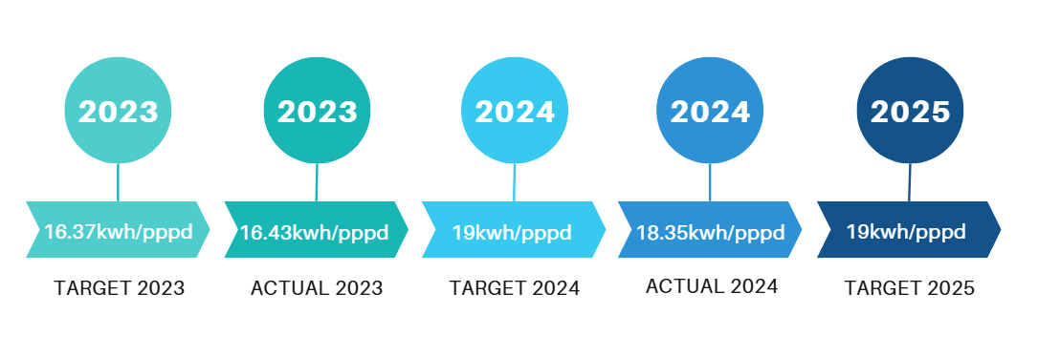
ELECTRICITY CONSUMPTION
ACTUAL 2022
TARGET 2023
ACTUAL 2023
TARGET 2024
In 2023, the hotel aimed to limit electricity consumption to 16.37 kWh per person per day (pppd), but achieved a slightly higher figure of 16.43 kWh/pppd. This minimal deviation (+0.06 kWh/pppd) indicates strong performance, especially considering fluctuations in occupancy and the operational demands typical of a luxury property.
For 2024, the target was set higher, at 19 kWh/pppd, taking into account the expected increase in demand due to the expansion of provided services — such as the in-house laundry facility — as well as the larger number of guests. Nevertheless, the hotel exceeded expectations, achieving 18.35 kWh/pppd. This result demonstrates the effectiveness of the energy-saving measures implemented, such as the optimization of HVAC systems, the use of LED lighting, and guest awareness programs.
Looking ahead, the target for 2025 remains at 19 kWh/pppd, which represents a realistic benchmark, given the potential increase in guests or additional amenities and services, while maintaining a commitment to sustainability.
Keeping consumption close to or below the target will likely depend on the continuous upgrading of energy efficiency and the staff’s commitment to energy management practices
Notes:
Βιωσιμότητα ή αειφορία είναι ένα πρότυπο παραγωγής το οποίο στοχεύει στο καλύτερο.

Slide 26
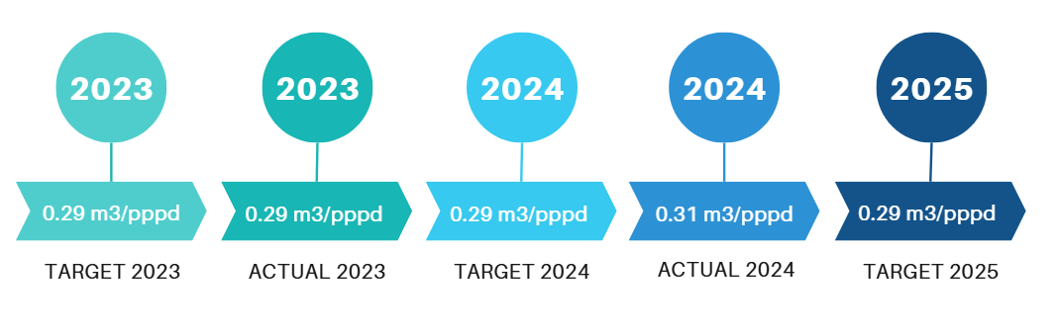
WATER CONSUMPTION
Despite maintaining water consumption at satisfactory levels in 2023, a slight increase (+0.02 m³/pppd) was recorded in 2024 compared to the established target. This variation is mainly attributed to higher occupancy rates and an increased number of visitors, as luxury properties typically host guests with greater demands for water-intensive services such as spa facilities and more frequent pool cleaning. Additionally, recent expansions and upgrades of the facilities — including the creation of new suites and the enlargement of dining areas — also contributed to the increase, as they require additional water resources.
For 2025, the water consumption target will remain unchanged. Despite the small increase in 2024, the hotel plans to implement additional sustainable management measures, such as:
Installation of sub-meters in kitchens and laundries for more accurate monitoring and control.
Use of water storage tanks for irrigation during the winter months, to minimize waste.
Through these interventions, the aim is to reduce consumption and maintain performance within the set targets, while further strengthening the hotel’s commitment to sustainable development.
Notes:
Βιωσιμότητα ή αειφορία είναι ένα πρότυπο παραγωγής το οποίο στοχεύει στο καλύτερο.

Slide 27
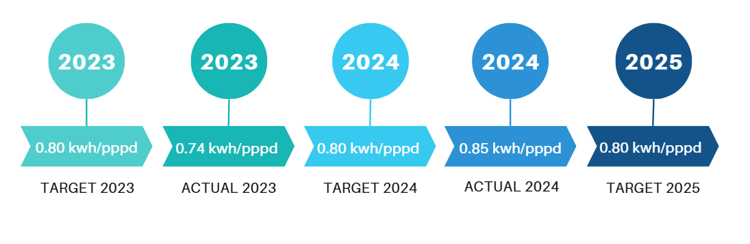
PETROL CONSUMPTION
Despite maintaining fuel consumption at satisfactory levels in 2023, a slight increase (+0.5 kWh/pppd) was recorded in 2024 compared to the set target. This rise is mainly attributed to lower temperatures during the year, which led to greater heating and hot water production needs. In addition, consumption was further increased due to the expansion of the hotel’s services, as the laundry facility now operates entirely in-house, resulting in a significantly higher overall energy demand.
For 2025, the fuel consumption target will remain unchanged. Despite the minor deviation in 2024, the hotel continues to focus on improving energy efficiency and strengthening its environmental responsibility. In this context, initiatives being implemented include:
Evaluation and exploration of more sustainable and environmentally friendly technologies for the existing boilers.
Systematic monitoring and analysis of consumption, in order to promptly identify energy-saving opportunities.
Through these actions, the hotel aims to stabilize or even reduce fuel consumption, while ensuring the continuous improvement of its environmental performance.
Notes:
Βιωσιμότητα ή αειφορία είναι ένα πρότυπο παραγωγής το οποίο στοχεύει στο καλύτερο.

Slide 28
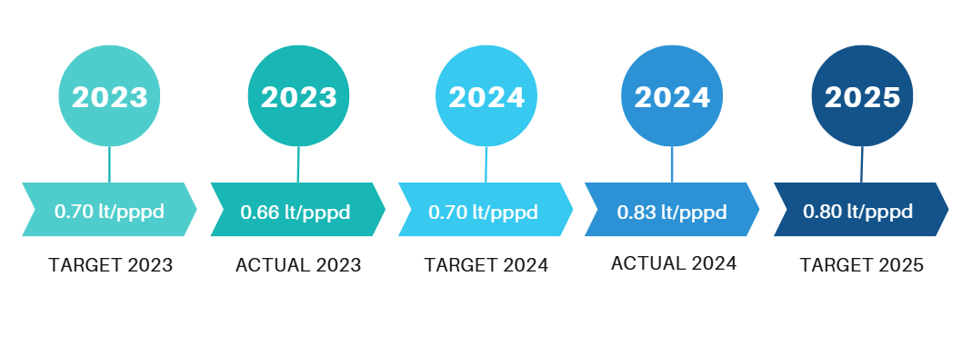
LPG CONSUMPTION
As shown, LPG consumption increased in 2024 compared to 2023. This rise is mainly attributed to the higher number of visitors, which led to greater cooking needs. At the same time, the hotel carried out expansions and upgrades to several facilities, such as the enlargement of the kitchen, the addition of new ironing equipment, and the full integration of the laundry operation within the premises. These factors collectively contributed to the significant increase in LPG consumption.
For these reasons, the LPG consumption target for 2025 is set higher, by +0.10 lt/pppd. This adjustment is considered reasonable, as the additional services and facilities introduced in 2024 have now become a permanent part of the hotel’s operations. Consequently, the new target realistically reflects current operational needs, while at the same time maintaining the commitment to responsible and efficient energy management.
Notes:
Βιωσιμότητα ή αειφορία είναι ένα πρότυπο παραγωγής το οποίο στοχεύει στο καλύτερο.

Slide 29
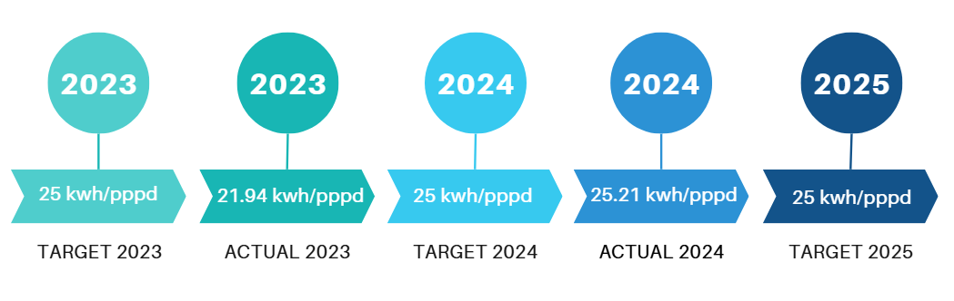
ENERGY CONSUMPTION
Total energy consumption is calculated by taking into account the consumption of electricity, water, oil, and LPG. In 2024, an increase was recorded compared to 2023, mainly due to higher demand for these resources. This rise was caused, on the one hand, by the larger number of guests, which created greater needs for heating, cooling, hot water, and other services, and on the other hand, by the expansions and upgrades of the hotel’s facilities, such as larger service areas and new equipment. In addition, the internalization of services — such as the laundry, which now operates fully in-house — further contributed to the overall energy expenditure, which shows a significant increase.
Reducing energy consumption remains a fundamental priority, as it not only contributes to lowering operating costs but also strengthens environmental responsibility and supports the achievement of sustainability goals. For this reason, the energy consumption target for 2025 will remain unchanged, ensuring consistency in the efforts to improve energy efficiency. Within this framework, the hotel has already adopted and continues to implement targeted strategies, such as:
Installation of energy-efficient lighting and heating/cooling systems.
Monitoring and analysis of consumption to identify saving opportunities in a timely manner.
Staff training and guest awareness programs on responsible resource use.
Through these actions, the hotel aims to stabilize and gradually reduce energy consumption, actively contributing to a more sustainable and environmentally responsible future.
Notes:
Βιωσιμότητα ή αειφορία είναι ένα πρότυπο παραγωγής το οποίο στοχεύει στο καλύτερο.

Slide 30
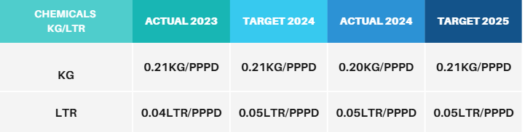
CHEMICAL PURCHASES
The monitoring and management of hazardous chemicals is a critical part of our commitment to sustainable operations. Our goal is the gradual reduction of these substances and their replacement with safer, more environmentally friendly alternatives. We actively work toward adopting less toxic, biodegradable products that reduce negative impacts on both the environment and human health.
At the same time, our efforts focus on reducing the overall carbon footprint associated with the chemicals used in the hotel’s daily operations, further reinforcing our commitment to sustainable practices.
In 2023, for the first time, we began systematically monitoring the procurement of hazardous chemicals, creating a database that allows us to evaluate their use and plan improvements in our supply processes. Based on this data, we set ambitious targets for 2024.
These targets were successfully achieved, enabling us to set the corresponding goals for 2025, thereby ensuring continuous progress in reducing hazardous chemicals and adopting more sustainable practices within the hotel.
Notes:
Βιωσιμότητα ή αειφορία είναι ένα πρότυπο παραγωγής το οποίο στοχεύει στο καλύτερο.

Slide 31
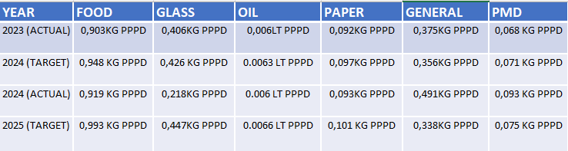
WASTE MANAGEMENT
Waste is a significant source of CO₂ emissions, which negatively impact the environment. As a hotel, our goal is to minimize all types of waste in order to reduce our carbon footprint and increase recycling rates. For this reason, we closely monitor each waste category and have set clear targets for 2025.
Based on the actual 2023 data, it was decided to increase recyclable collection by 5% in 2024 and by 10% in 2025. At the same time, the reduction target for residual (general) waste was set at -5% for 2024 and -10% for 2025.
As shown in the table, two of these targets were not achieved in 2024, specifically regarding PMD recycling and general waste.
For 2025, the hotel is committed to intensifying efforts to achieve these goals by implementing:
Ongoing staff training for proper waste management and source separation.
Close monitoring of supplies and purchases to minimize waste generation from the outset.
Systematic evaluation of waste streams and continuous feedback for ongoing improvement.
With these measures, we aim to steadily improve recycling performance and meet the hotel’s sustainability goals, while at the same time contributing to environmental protection.
Notes:
Βιωσιμότητα ή αειφορία είναι ένα πρότυπο παραγωγής το οποίο στοχεύει στο καλύτερο.

Slide 32
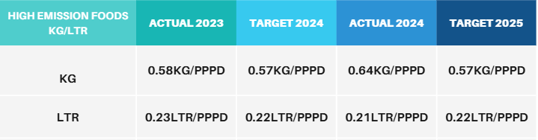
HIGH EMISSION FOODS
The reduction of food consumption with a high carbon footprint is an important step toward lowering a hotel’s overall environmental footprint. In 2023, we began for the first time to systematically monitor the procurement of high-emission foods, thereby creating a database that allows us to evaluate and improve our purchasing practices. Based on this data, we set ambitious targets for 2024.
With regard to foods purchased in liters, the hotel successfully achieved the 2024 target. However, in the category of foods purchased in kilograms, an increase was recorded that exceeded the original target.
The target for 2025 will remain unchanged, despite the deviations in 2024. The hotel will implement specific strategies for sustainable procurement, such as:
Selecting suppliers that use environmentally friendly production systems.
Prioritizing products with lower CO₂ emissions per kilogram.
Adjusting the menu to reduce the use of high-emission foods, without compromising quality or variety for guests.
Training staff in the principles of sustainable food management and proper use of stock.
Through these actions, the hotel aims to steadily reduce high-emission foods and maintain its commitment to sustainable operations, while also contributing to CO₂ reduction.
Notes:
Βιωσιμότητα ή αειφορία είναι ένα πρότυπο παραγωγής το οποίο στοχεύει στο καλύτερο.

Slide 33
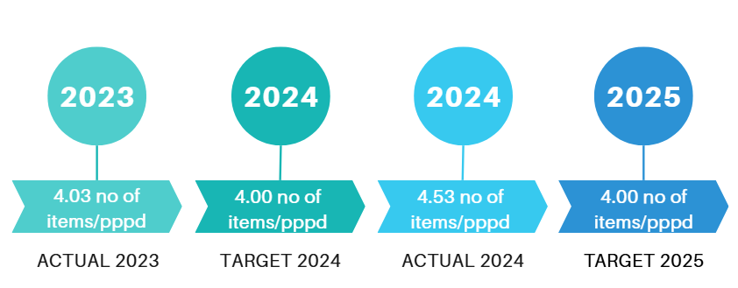
SINGLE USE PLASTICS
The reduction of single-use plastics in hotel operations is an important step toward lowering our environmental footprint. In 2023, we began for the first time to systematically monitor the consumption of single-use plastics and, at the same time, eliminated all plastics prohibited under current European legislation. In this way, we created a database that allows us to measure future improvements and identify areas where further reduction is possible.
Using this data, we set ambitious targets for 2024. However, the target was not achieved, as single-use plastic consumption per person per day was higher than expected.
This outcome highlights the need for action at the management level to develop and implement specific strategies for transitioning to sustainable alternatives. Such strategies may include:
Replacing plastic items with recyclable or reusable materials.
Training staff and informing guests on the proper use and reduction of single-use plastics.
Monitoring purchases and supplies to minimize the introduction of new plastic products into the hotel.
Adopting supplier standards that commit to environmentally friendly packaging.
Through these actions, the hotel aims to gradually reduce the use of single-use plastics, contributing significantly to the reduction of waste and CO₂ emissions, while at the same time strengthening its commitment to sustainable operations.
Notes:
Βιωσιμότητα ή αειφορία είναι ένα πρότυπο παραγωγής το οποίο στοχεύει στο καλύτερο.

Slide 34
GREENHOUSE GAS EMISSION AND BIODIVERSITY GOALS FOR 2024
Electricity consumption per guest per overnight stay: 19 kWh
Water consumption per guest per overnight stay: 0.29 m³/PPPD
Gasoline consumption per guest per overnight stay: 0.80 kWh/PPPD
LPG consumption per guest per overnight stay: 0.80 lt/PPPD
Glass item/packaging recycling: 0.447 kg/PPPD
PMD (Plastic, Metal, Drink cartons) recycling: 0.075 kg/PPPD
Paper recycling: 0.101 kg/PPPD
Chemical purchases in liters: 0.05 lt/PPPD, in kilograms: 0.21 kg/PPPD
Used cooking oil recycling: 0.066 kg/PPPD
Adoption of at least 2 sustainable development practices
60% of our staff from the local community
Community support (blood donation, beach cleaning, contributions)
Biodiversity support as supporters and members of CSTI and the “Keep our sand and sea plastic free” project by participating in all events.
Notes:
Βιωσιμότητα ή αειφορία είναι ένα πρότυπο παραγωγής το οποίο στοχεύει στο καλύτερο.

Slide 35
THANK YOU!

